Slide 1
Leading Causes of Injury in North Carolina, 2023
Division of Public Health
Data updated: March 13, 2025
Notes:
This slide set was created to provide basic data trends and public health surveillance around mortality and morbidity of the leading causes of injury in North Carolina. They are meant to offer a state-level background on the leading causes of injury. If you’d like a copy of the slides, please visit the “Data Surveillance” page on our branch website, www.dph.ncdhhs.gov/programs/chronic-disease-and-injury/injury-and-violence-prevention-branch. The direct link is also shared at the end of this presentation.
Feel free to incorporate these slides into your own presentations, grant proposals, reports, or any other way they may be useful.
Please read both the speaking and technical notes to ensure that data are presented in a consistent manner.

Slide 2
Leading Causes of Injury Technical Notes
Surveillance methods have been updated to identify any mention of an injury in our morbidity data sources. Individual records with multiple injuries listed will be included in the total for each of those injuries but counted only once for the overall total injury count. Previously, only the first listed injury was counted, which has increased in number of specific injuries identified.
For questions or for more information, see the technical notes document available at:
https://injuryfreenc.dph.ncdhhs.gov/DataSurveillance/Technical-Notes.pdf?ver=1.0
Notes:
For more detailed technical notes on any of the data shared in this slide set, please contact us at InjuryData@dhhs.nc.gov.

Slide 3
Injury deaths are just the tip of the iceberg.
In 2023, injuries resulted in:
11,705
Deaths
53,616
Hospitalizations
Despite NC’s extensive reporting systems,
the total burden
of injuries in the
state is
unknown.
939,765
ED Visits
? EMS
? Outpatient Injuries
? Medically Unattended Injuries
INJURY ICEBURG
Limited to NC Residents, 2023
Source: NC State Center for Health Statistics, Vital Statistics Deaths (2023) and Hospital Discharge Data (2023); NC DETECT (2023)
Analysis by the DPH, Injury and Violence Prevention Branch, Injury Epidemiology, Surveillance and Informatics Unit
Notes:
In 2023 there were 11,705 deaths, 53,616 hospitalizations, and 939,765 emergency department visits associated with injuries in North Carolina. However, this is just the tip of the iceberg and the total burden of injury in North Carolina is unknown.

Slide 4
Injury Deaths

Slide 5
Injury deaths among NC residents continue to rise
38%
increase
Data limited to NC residents, 2019-2023
Source: NC State Center for Health Statistics, Vital Statistics Deaths (2019-2023)
Analysis by the DPH, Injury and Violence Prevention Branch, Injury Epidemiology, Surveillance and Informatics Unit
Notes:
The number of injury deaths in North Carolina continues to rise, with a 38% increase since 2019.

Slide 6
Leading causes of injury death among NC Residents, 2023
The leading cause of injury death in 2023 was unintentional poisoning.
Total Deaths = 11,705
MVT = Motor Vehicle Traffic; Unintentional poisoning includes both medication/drug overdoses and non-drug poisonings
Data limited to NC residents, 2023
Source: NC State Center for Health Statistics, Vital Statistics Deaths (2023)
Analysis by the DPH, Injury and Violence Prevention Branch, Injury Epidemiology, Surveillance and Informatics Unit
Notes:
In 2023, there were 11,705 injury deaths in North Carolina. The leading cause of injury death was unintentional poisoning (n=4,286), followed by unintentional falls (n=2,007) and unintentional motor vehicle traffic-related injury (n=1,757).

Slide 7
Percent change in leading causes of injury death among NC residents, 2019-2023
Unintentional poisoning had the largest five-year increase.
MVT = Motor Vehicle Traffic
Data limited to NC residents, 2019 & 2023
Source: NC State Center for Health Statistics, Vital Statistics Deaths (2019 & 2023)
Analysis by the DPH, Injury and Violence Prevention Branch, Injury Epidemiology, Surveillance and Informatics Unit
Notes:
Over the past five years (2019-2023), the number of deaths due to unintentional poisonings increased the most (85% increase), followed by firearm assault (31% increase) and unintentional falls (30% increase). The 35% decrease in deaths for unspecified injuries notes a shift toward better injury coding practices.

Slide 8
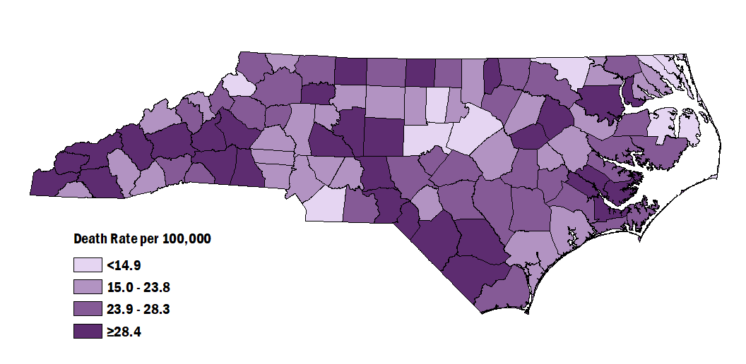
Injury Death Rates among NC Residents by County, 2019-2023
Statewide, the rate of injury deaths from 2019-2023 was 23.1 per 100,000 people.
Data limited to NC residents, 2019-2023
Source: NC State Center for Health Statistics, Vital Statistics Deaths (2019-2023)
Analysis by the DPH, Injury and Violence Prevention Branch, Injury Epidemiology, Surveillance and Informatics Unit
Notes:
The rate of injury deaths among North Carolinians from 2019 to 2023 was 23.1 per 100,000 residents. Counties with the highest rates included Robeson (48.7 per 100,000), Cherokee (39.7 per 100,000), and Bladen (38.5 per 100,000). Counties with the lowest rates included Watauga (10.9 per 100,000), Orange (12.5 per 100,000), and Wake (13.1 per 100,000).

Slide 9
Injury Hospitalizations

Slide 10
Injury-related hospitalizations increased by 7% over the last five years
7%
increase
Data limited to NC residents, 2019-2023
Source: Hospitalization Discharge Data (2019-2023)
Analysis by the DPH, Injury and Violence Prevention Branch, Injury Epidemiology, Surveillance and Informatics Unit
Notes:
In 2023, the number of injury-related hospitalizations in North Carolina increased by 7% since 2019.

Slide 11
Leading causes of injury hospitalization among NC Residents, 2023
The leading cause of injury hospitalization in 2023 was unintentional falls.
Total Hospitalizations = 53,616
MVT = Motor Vehicle Traffic; Unintentional poisoning includes both medication/drug overdoses and non-drug poisonings
Data limited to NC residents, 2023
Source: Hospital Discharge Data (2023)
Analysis by the DPH, Injury and Violence Prevention Branch, Injury Epidemiology, Surveillance and Informatics Unit
Notes:
In 2023, there were 53,616 injury-related hospitalizations in North Carolina. The leading cause of injury hospitalization was unintentional falls (n=27,880), followed by unintentional motor vehicle traffic-related injury (n=7,495) and unintentional poisoning (n=6,045).

Slide 12
Percent change in leading causes of injury hospitalization among NC residents, 2019-2023
Unintentional firearm injuries had the largest five-year increase.
MVT = Motor Vehicle Traffic
Data limited to NC residents, 2019 & 2023
Source: Hospital Discharge Data (2019 & 2023)
Analysis by the DPH, Injury and Violence Prevention Branch, Injury Epidemiology, Surveillance and Informatics Unit
Notes:
Over the past five years (2019-2023), the number of hospitalizations due to unintentional firearm injury increased the most (60% increase). The 23% decrease in hospitalizations for “no mech or intent determined” notes a shift toward better injury coding practices.

Slide 13
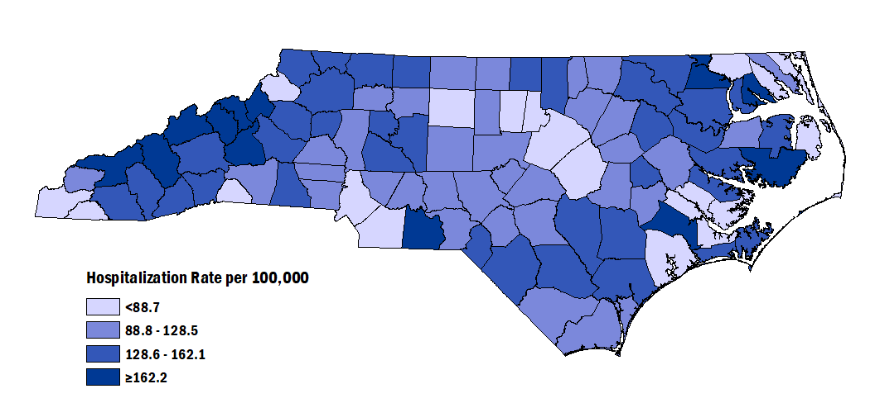
Injury Hospitalization Rates among NC Residents by County, 2019-2023
Statewide, the rate of injury hospitalizations from 2019-2023 was 107.7 per 100,000 people.
Data limited to NC Residents, 2019-202293
Source: Hospital Discharge Data (2019-2023)
Analysis by the DPH, Injury and Violence Prevention Branch, Injury Epidemiology, Surveillance and Informatics Unit
Notes:
The rate of injury hospitalization among North Carolinians from 2019 to 2023 was 107.7 per 100,000 residents. Counties with the highest rates included Hertford (641.7 per 100,000), Mitchell (178.9 per 100,000), and Jones (176.7 per 100,000). Counties with the lowest rates included Currituck (35.0 per 100,000), Onslow (52.5 per 100,000), and Pasquotank (55.0 per 100,000).

Slide 14
Injury Emergency Department (ED) Visits

Slide 15
Injury-related ED visits remain high, but increased 2% over the last five years
2%
increase
Data limited to NC residents, 2019-2023
Source: NC DETECT, 2019-2023
Analysis by the DPH, Injury and Violence Prevention Branch, Injury Epidemiology, Surveillance and Informatics Unit
Notes:
The number of injury-related emergency department visits in North Carolina has increased by 2% over the last 5 years (2019-2023). A decrease was observed until the pandemic in 2020. Since 2020, the number of injury-related ED visits has increased by 26%.

Slide 16
Leading causes of injury ED Visits among NC Residents, 2023
The leading cause of injury ED visits in 2023 was unintentional falls.
Total ED Visits = 939,765
Data limited to NC residents, 2023
Source: NC DETECT, 2023
Analysis by the DPH, Injury and Violence Prevention Branch, Injury Epidemiology, Surveillance and Informatics Unit
Notes:
In 2023, there were 936,765 injury-related ED visits in North Carolina. The leading cause of injury ED visit was unintentional falls (n=259,507) and unintentional motor vehicle traffic-related injury (n=121,930). The high number of ED visits with no mechanism or intent determined (n=290,275) shows the need for better injury coding practices in emergency department settings.

Slide 17
Percent change in leading causes of injury ED visits among NC residents, 2019-2023
Unintentional poisoning had the largest five-year increase.
Data limited to NC residents, 2019 & 2023
Source: NC DETECT, 2019 & 2023
Analysis by the DPH, Injury and Violence Prevention Branch, Injury Epidemiology, Surveillance and Informatics Unit
Notes:
Over the past five years (2019-2023), the number of ED visits due to unintentional poisoning increased the most (48% increase).

Slide 18
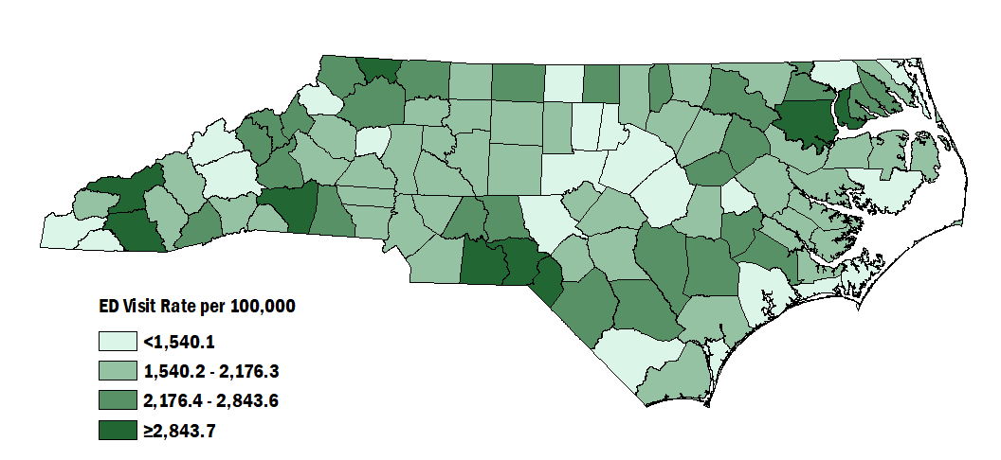
Injury ED Visit Rates among NC Residents by County, 2019-2023
Statewide, the rate of injury Ed visits from 2019-2023 was 1,916.7 per 100,000 people.
Data limited to NC residents, 2019-2023
For more information on these data, see the Injury Surveillance Technical Notes: https://www.injuryfreenc.ncdhhs.gov/DataSurveillance/Technical-Notes.pdf
Source: NC DETECT, 2019-2023
Analysis by the DPH, Injury and Violence Prevention Branch, Injury Epidemiology, Surveillance and Informatics Unit
Notes:
The rate of injury ED visits among North Carolinians from 2019 to 2023 was 1,916.7 per 100,000 residents. Counties with the highest rates included Anson (3,765.0 per 100,000), Richmond (3,387.4 per 100,000), and Chowan (3,263.2 per 100,000). Counties with the lowest rates included Clay (875.5 per 100,000), Currituck (883.0 per 100,000), and Chatham (1,064.1 per 100,000).

Slide 19
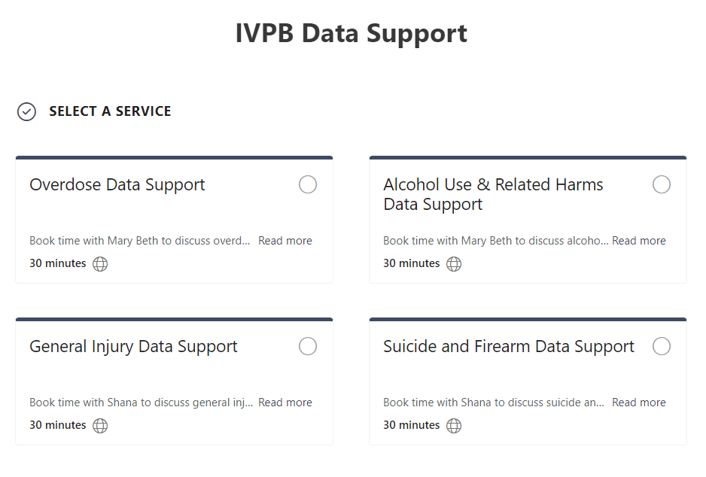

IVPB Data Support now available!
Book time with an IVPB epidemiologist to discuss available data products, to talk through custom data requests, or for general data questions.
IVPB Data Request Policy
IVPB Data Support Bookings

Slide 20
Questions?
InjuryData@dhhs.nc.gov
Injury and Violence Prevention Branch
NCDHHS Division of Public Health
www.dph.ncdhhs.gov/programs/chronic-disease-and-injury/injury-and-violence-prevention-branch

